Slide 1

Travel Companion App
By Allen Hadzic

Slide 2

What it Does
Most of the existing conversion utilities are very complicated to use and offer too many conversion choices which, for the average traveler is unnecessary
This multipurpose GUI app simplifies the unit conversion process
It is designed for travelers going to Europe and travelers going to the US
It has regular calculator functions plus 16 of the most common metric to imperial unit conversion functions
The unit conversions are done simply by clicking one button on the screen

Slide 3
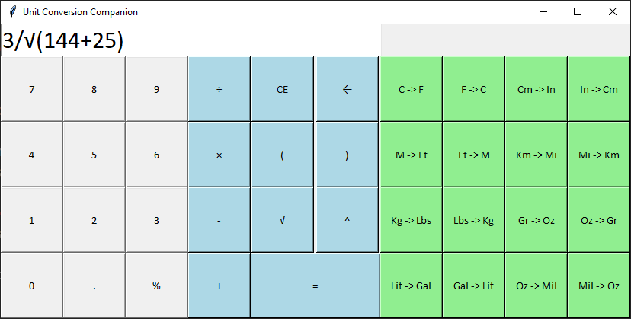
How it works:
Works as a standard calculator
Does common formulas including square root and exponents
Uses mouse or keyboard to operate
Also performs simple percentage conversions from fractions
Find it on GitHub-> https://github.com/ksu-is/Travel_Companion

Slide 4
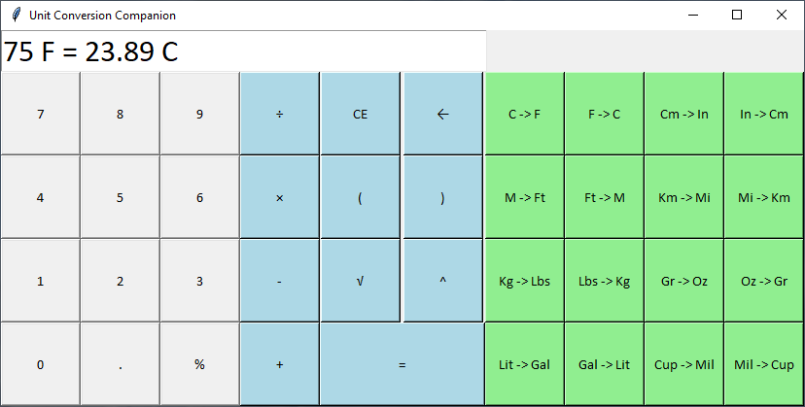
Main Features:
Converts 16 of the most common US and metric measurements and vice versa
Uses Keyboard or Mouse for data entry
Displays the result in meaningful way
Converts input with one Mouse click

Slide 5

Thank You and Happy Travels !

